Slide 1

Department of Information Technology
Session 2024-25
Major Project Progress Seminar-I On
Deepfake Image Detection With Meta Learning
Presented By Group No: 11
Mr. Ashutosh Dekate (Roll no:141)
Mr.Bhagyesh Nand (Roll no:144)
Mr.Kartik Nagrale (Roll no:154)
Mr.Sumedh Bhagat (Roll no:167)
Guided By
Dr.Nisha Wankhade
Notes:
‹#›

Slide 2
Contents
Abstract
Introduction
Problem Definition
Aim & Objectives
Literature Survey
Patent Search
Research Gap
Hardware Software Requirement
Proposed Methodology
Experimental Results
How it is useful for society
Plan of action
Conclusion and Future Scope
References

Slide 3
Abstract
Deepfake technology creates highly realistic but manipulated images, posing threats like misinformation and identity theft.
This project develops a deepfake image detection system using machine learning, specifically convolutional neural networks (CNNs), to identify inconsistencies in features, lighting, and textures. A dataset of real and deepfake images is used for training and evaluation.
The system will be optimized for accuracy that can be integrated into platforms to combat deepfake misuse, promoting trust in digital media.
Deepfake Image Detection with Meta Learning

Slide 4
Introduction
Deepfake technology poses serious challenges, including the spread of misinformation, where manipulated media distorts facts and influences public opinion, leading to trust issues in news and digital communication. It also raises significant privacy concerns, as individuals' images can be misused without consent for identity theft or reputational harm. Furthermore, deepfakes undermine authenticity, making it increasingly difficult to distinguish real content from fake, eroding trust in digital media. These issues highlight the urgent need for advanced tools to preserve integrity and authenticity in the digital age.
Deepfake Image Detection with Meta Learning

Slide 5
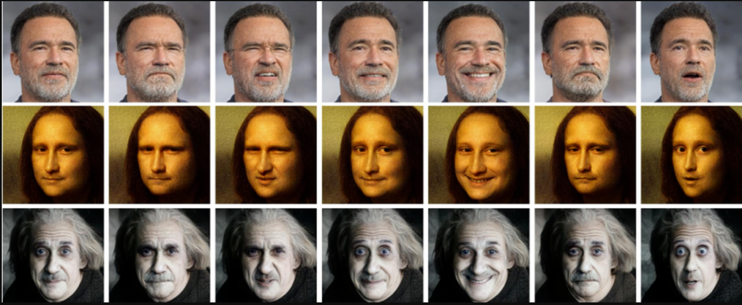
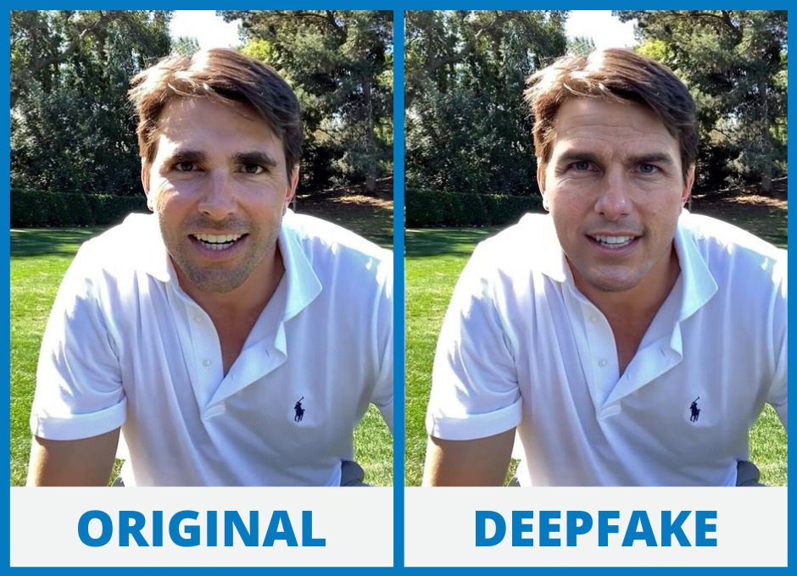
Introduction
Deepfake Image Detection with Meta Learning

Slide 6
Problem Definition
The rise of deepfake technology has led to the creation of highly realistic yet manipulated media that poses significant societal challenges.
These include the spread of misinformation, breaches of privacy, and the erosion of trust in content authenticity.
Existing detection systems often struggle to keep up with the rapidly evolving methods used to generate deepfakes, resulting in inadequate protection against their misuse.
Deepfake Image Detection with Meta Learning

Slide 7
Aim and Objectives
To address these challenges, there is a critical need for a robust and adaptive detection model capable of identifying deepfakes with high accuracy.
The proposed model combines transfer learning approach, Convolutional Neural Networks (MobileNetV2), Meta-learning, to enhance detection capabilities.
By leveraging these advanced techniques, the system can adapt to evolving deepfake generation methods, reliably detect manipulated media, and uphold information integrity in digital platforms.
This solution is essential to mitigate the growing threats posed by deepfakes and ensure trust in digital communication.
Deepfake Image Detection with Meta Learning

Slide 8
Literature Survey
Sr. No. | Title of the paper | Author | Year of Publication/ Publisher | Major observations/findings
1 | Fine-Grained Open-Set Deepfake Detection via Unsupervised Domain Adaptation | Xinye Zhou, Hu Han, Shiguang Shan, Xilin Chen | 01 January 2024 IEEE Transactions on Information Forensics and Security, Volume 19 | This study proposes an unsupervised domain adaptation method for fine-grained open-set deepfake detection. The approach focuses on adapting the detection model to new, unseen deepfake types without requiring labeled data from those categories.
2 | Exposing Deepfake Face Forgeries With Guided Residuals by Y. Zhang et al. | Zhiqing Guo, Gaobo Yang, Jiyou Chen, Xingming Sun | 2 May 2022 IEEE Transactions on multimedia, Volume 25 | This research introduces a method that utilizes residual-based features to preserve tampering traces while suppressing irrelevant image content. The guided residuals enhance the detection of subtle artifacts introduced during deepfake generation
‹#›
Deepfake Image Detection with Meta Learning
Notes:
‹#›

Slide 9
Literature Survey
Sr. No. | Title of the paper | Author | Year of Publication/ Publisher | Major observations/findings
3 | Exposing Face Forgery Across Domains via Bi-Directional Adaptation by L. Wang et al | Qingxuan Lv, Yuezun Li, Junyu Dong, Sheng Chen, Hui Yu, Huiyu Zhou, Shu Zhang | 2024 IEEE TRANSACTIONS ON INFORMATION FORENSICS AND SECURITY, VOL. 19, | Proposed a bi-directional domain adaptation framework for cross-domain robustness.
4 | Enhancing Deepfake Detection With Diversified Self-Blending Images and Residuals | Ahmed Abul Hasanaath, Hamzah Luqman, Raed Katib, Saeed Anwar | 12 Jun 2024 SDAIA-KFUPM Joint Research Center for Artificial Intelligence | Introduced a Fake Blender module to generate diverse synthetic images, improving training data diversity
‹#›
Deepfake Image Detection with Meta Learning
Notes:
‹#›

Slide 10
Literature Survey
Sr. No. | Title of the paper | Author | Year of Publication/ Publisher | Major observations/findings
5 | Using Graph Neural Networks to Improve Generalization Capability of the Models for Deepfake Detection | H She, Y Hu, B Liu, J Li, Chang-Tsun LiChang-Tsun Li | 2024 IEEE Transactions on Information Forensics and Security. Vol 19 | Represented images as graphs and employed Graph Neural Networks (GNNs) to detect deepfake manipulations.
6 | Meta-Learning in Neural Networks: A Survey | Timothy Hospedales, Antreas Antoniou, Paul Micaelli, Amos Storkey | 2021 IEEE Transactions on Pattern Analysis and Machine Intelligence | Explains about applications and successes of meta-learning such as few-shot learning and reinforcement learning
Deepfake Image Detection with Meta Learning
Notes:
‹#›

Slide 11
Patent Search
Sr. No. | Title of the paper | Author | Year of Publication/ Publisher | Major observations/findings
1 | Deepfake video detection system and method | Jung-Shian LII-Hsien LiuChuan-Kang LiuPo-Yi WuYen-Chu Peng | 2022-11-29 United States Patent | The present disclosure relates to facial recognition, and in particular to a system and method of detecting changes in the state of human eyes in a video, quantifying the behavior of the eye features based on time using deep learning, and then integrating statistical models to determine whether the video has been faked or altered.
2 | Adaptive Meta-Learning for Robust Deepfake Detection: | Dinesh Srivasthav P, Badri Narayan Subudhi | 2022 India Patent | This paper addresses the challenges of deepfake detection, by proposing meta-learning algorithm that enhances model performance.
‹#›
Deepfake Image Detection with Meta Learning
Notes:
‹#›

Slide 12
Patent Search
Sr. No. | Title of the paper | Author | Year of Publication/ Publisher | Major observations/findings
3 | Methods and systems for detecting deepfakes | Michael Morgan PriceMatthew Alan Price | 2024-04-16 United States Patent | A system for detecting synthetic videos includes a server, multiple weak classifiers, and a strong classifier. Weak classifiers are trained on real and synthetic videos to analyze distinct characteristics, detect irregularities, and generate predictions on whether a video is synthetic. The server collects these predictions and sends them to the strong classifier. The strong classifier, trained to analyze the weak classifiers' predictions, determines if the video is synthetic based on the aggregated results.
Deepfake Image Detection with Meta Learning
Notes:
‹#›

Slide 13
Research Gap
Issues:
Imbalance Between Real and Fake Samples: Existing datasets often have an imbalance between the number of real and deepfake samples. This imbalance can skew the performance of detection algorithms, making them less effective in real-world scenarios where deepfakes may be less prevalent.
Adaptation to Evolving Deepfake Techniques: As deepfake generation methods continue to evolve, many existing detection algorithms struggle to adapt. There is a need for research that focuses on creating adaptive models capable of identifying new and sophisticated deepfake techniques.
Need for Robust Models: Current models often struggle with overfitting, particularly when trained on limited data. There is a pressing need for more robust architectures that can maintain high accuracy while being less prone to overfitting.
Generalization to Unseen Data: Many models are trained on specific datasets and fail to generalize across various deepfake generation techniques.
Deepfake Image Detection with Meta Learning
Notes:
‹#›

Slide 14
Research Gap
Solution:
Deepfake Detection using CNN : Studies have used convolutional neural networks (CNNs) to detect deepfakes, achieving high accuracy rates
MobileNet for Deepfake Detection : The study proposes a deep-learning method called MobileNet, which utilizes compact convolutional neural networks to detect manipulated facial expressions with high accuracy which is pretrained on ImageNet
Face Forensics: Researchers have proposed face forensics methods to detect deepfakes, including analyzing facial expressions, eye movements, and skin texture
Meta Learning Implementation: Meta Learning frameworks, such as Model-Agnostic Meta-Learning (MAML) can be used to detect deepfakes.
Deepfake Image Detection with Meta Learning
Notes:
‹#›

Slide 15
Hardware/Software Requirement
Hardware Details : For a software, an effective hardware components are required in a computer.
Operating System: Windows 10 or newer, macOS, or Linux.
Memory: At least 2 GB of RAM is recommended for smooth operations.
Disk Space: Minimum 2 GB of free disk space for installing and functioning Jupyter Notebook and its dependencies.
Processor : Pentium IV 2.6GHZ or above
Hard disk Space: 512 GB
Software Details :To run a system efficiently, software must be installed.
Operating System: Windows 10 or above
Languages used: Python, Py-Libraries
Software used: Jupyter Notebook and Visual Studio code and more
Deepfake Image Detection with Meta Learning
Notes:
‹#›

Slide 16
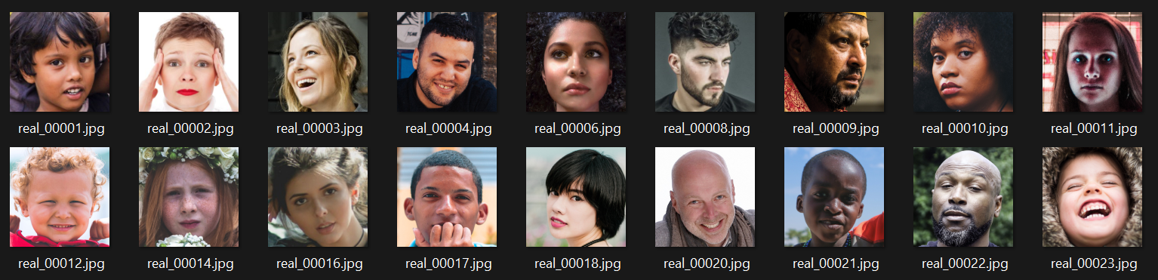
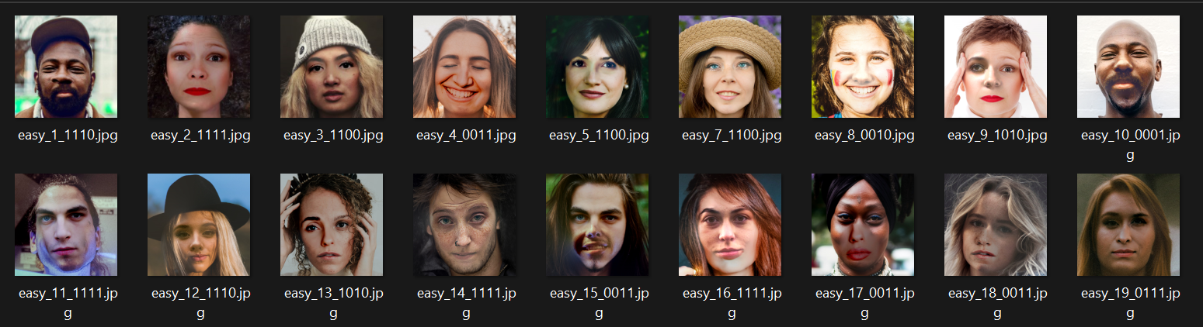
Dataset
Real Images
DeepFake Images
Deepfake Image Detection with Meta Learning
Notes:
‹#›

Slide 17
Proposed Methodology
Data Collection and Preprocessing
Collect a large dataset of real face images or videos from various sources, such as:
Publicly available datasets (e.g., FaceForensics++, Deepfake Detection Dataset)
Web scraping
Crowdsourcing
Feature Extraction using MobileNetV2:
MobileNetV2 is a lightweight convolutional neural network pretrained on ImageNet. We remove the top classification layers and use it as a feature extractor.
Low-Level Features:
Edges, textures, and patterns extracted by the initial layers of MobileNetV2.
Mid-Level Features:
Shapes, contours, and more complex patterns extracted by intermediate layers.
High-Level Features:
Semantic information (e.g., facial features, artifacts) extracted by the deeper layers of MobileNetV2.
Deepfake Image Detection with Meta Learning
Notes:
‹#›

Slide 18
Proposed Methodology
Input Shape: (150, 150, 3)
Batch Size: 32 (used during training).
Loss Function: Binary cross-entropy (for binary classification).
Optimizer: Adam / SGD.
Activation Functions: ReLU for hidden layers. Sigmoid for the output layer.
Callbacks: Early stopping, Reduce learning rate on plateau
Global Average Pooling Layer:
Converts extracted feature maps into a single 1D vector, reducing dimensionality while retaining key information.
Deepfake Image Detection with Meta Learning
Notes:
‹#›

Slide 19
Proposed Methodology
Meta-Learning
1. Implement a meta-learning algorithm (e.g., Model-Agnostic Meta-
Learning (MAML)) using pytorch or tensorflow.
2. Train the meta-learning model on the deepfake face images or videos.
3. Evaluate the meta-learning model on the validation set.
ML Libraries:
- pytorch or tensorflow for building and training the meta-learning model
- learn2learn library for meta-learning algorithms
Hyperparameter Tuning and Model Deployment
1. Perform hyperparameter tuning for the ensemble model using optuna or hyperopt.
2. Deploy the ensemble model using tensorflow-serving or pytorch-serving.
Deepfake Image Detection with Meta Learning
Notes:
‹#›

Slide 20
Proposed Methodology
Data Collection and Preprocessing
Deepfake detection Model Development
Testing
Meta Learning Model Development
Hyperparameter Tuning and Model Deployment
Deepfake Image Detection with Meta Learning
Notes:
‹#›

Slide 21
Proposed Architecture
Training on Dataset (150*150*3)
Feature Extraction using MobileNetV2
Global Average Pooling Layer Fully Connected Layers
Model Training Process
Model Testing
Model Deployment
Hyperparameter Tuning
Fine Tuning
Development of Meta Learning Algorithm
Deepfake Image Detection with Meta Learning
Notes:
‹#›

Slide 22
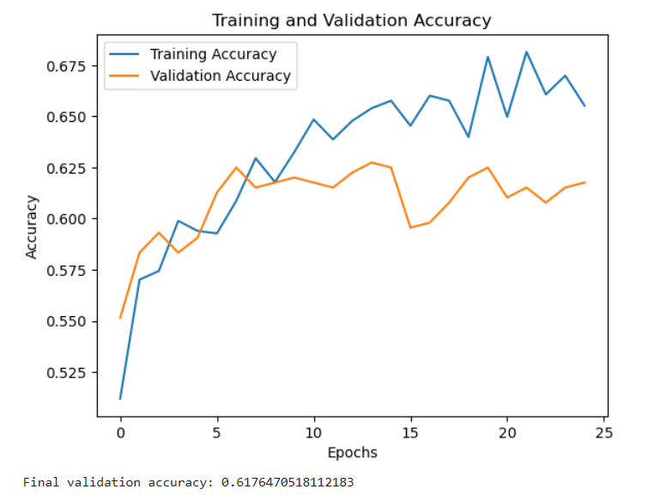
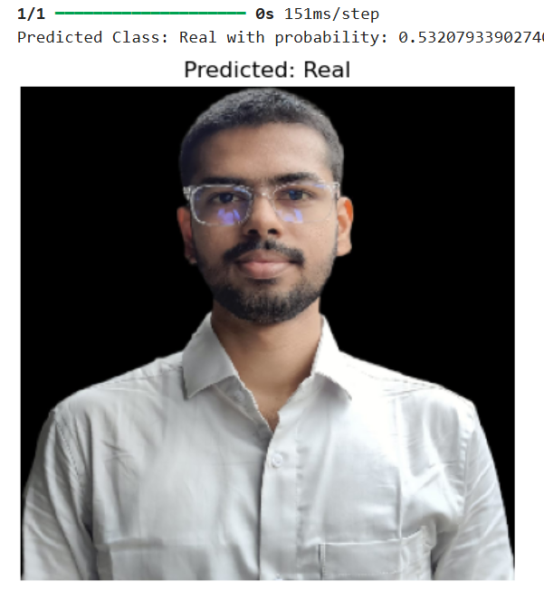
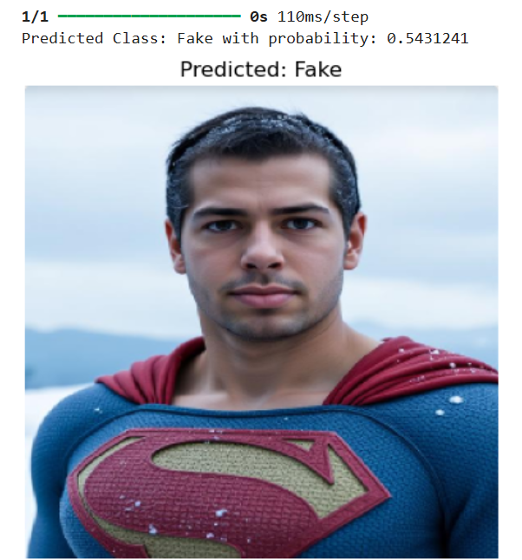
Experimental Results
Deepfake Image Detection with Meta Learning
Notes:
‹#›

Slide 23
How it is useful for Society
Prevents Misinformation: Stops the spread of fake news and disinformation.
Protects Individuals: Shields people from identity theft, reputation damage, and fraud.
Safeguards Political Integrity: Prevents the use of deepfakes to manipulate elections or political narratives.
Supports Law Enforcement: Helps in identifying fake evidence in legal or criminal investigations.
Enhances Media Trust: Assures the authenticity of news and media content, maintaining public trust.
Deepfake Image Detection with Meta Learning
Notes:
‹#›

Slide 24
Plan of Action
Activity (2025) | Jan | Feb | March | April | May
Literature Survey | Done
Data Collection | Done
Data Cleaning and Feature engineering |  | done
Model Building for selecting correct Machine Learning Algorithm |  | done
Accuracy Increasing and implementation of Meta Learning |  |  | working
Fine Tuning and Deployment
Preparation of Project Report/Paper Writing
Paper publishing
Thank You…….
23
Deepfake Image Detection

Slide 25
Conclusion and Future Scope
Conclusion:
The deepfake detection system was successfully implemented using MobileNetV2, combined with GlobalAveragePooling2D and a fully connected Dense layer for classification.
The lightweight nature of MobileNetV2 ensures efficient processing, making it suitable for real-time applications.
The model effectively differentiates between real and deepfake images, enhancing digital media security and trust.
This approach provides a balance between accuracy and computational efficiency, making it practical for deployment on various platforms.
Deepfake Image Detection with Meta Learning
Notes:
‹#›

Slide 26
Conclusion and Future Scope
Future Scope:
Optimization for Edge Devices: Adapting the model for mobile and IoT devices for on-the-go deepfake detection.
Improved Robustness: Enhancing the model’s ability to detect adversarial deepfakes by fine-tuning feature extraction techniques.
Real-Time Detection: Further reducing inference time to enable real-time deepfake identification in videos and streaming content.
Integration with Cybersecurity Frameworks: Deploying the model into content moderation tools and digital forensics systems.
Expansion to Multimodal Deepfakes: Extending detection capabilities to video and audio-based deepfake manipulation.
Deepfake Image Detection with Meta Learning
Notes:
‹#›

Slide 27
Roles and Responsibility
Team Member Details | Roles and Responsibility
(Team Captain) – Bhagyesh Nand | Research Work and Implementation
Sumedh Bhagat | Research Work and Implementation
Kartik Nagrale | Research Work and Implementation
Ashutosh Dekate | Research Work and Implementation
Deepfake Image Detection with Meta Learning
Notes:
‹#›

Slide 28
References
Zhiqing Guo, Gaobo Yang, Jiyou Chen, and Xingming Sun. 2023. Exposing Deepfake Face Forgeries With Guided Residuals. Trans. Multi. 25 (2023), 8458–8470. https://doi.org/10.1109/TMM.2023.3237169
Xinye Zhou, Hu Han, Shiguang Shan, and Xilin Chen. 2024. Fine-Grained Open-Set Deepfake Detection via Unsupervised Domain Adaptation. Trans. Info. For. Sec. 19 (2024), 7536–7547. https://doi.org/10.1109/TIFS.2024.3435440
Lv, Qingxuan & Li, Yuezun & Dong, Junyu & Chen, Sheng & Yu, Hui & Zhou, Huiyu & Shu, Zhang. (2024). DomainForensics: Exposing Face Forgery Across Domains via Bi-Directional Adaptation. IEEE Transactions on Information Forensics and Security. PP. 1-1. 10.1109/TIFS.2024.3426317.
https://patents.google.com/patent/US20210142065A1/en
https://patents.google.com/patent/US20220129664A1/en
P, Dinesh & Subudhi, Badri. (2024). Adaptive Meta-Learning for Robust Deepfake Detection: A Multi-Agent Framework to Data Drift and Model Generalization. 10.48550/arXiv.2411.08148.
Deepfake Image Detection with Meta Learning
Notes:
‹#›

Slide 29
Thank You…….

